Slide 1
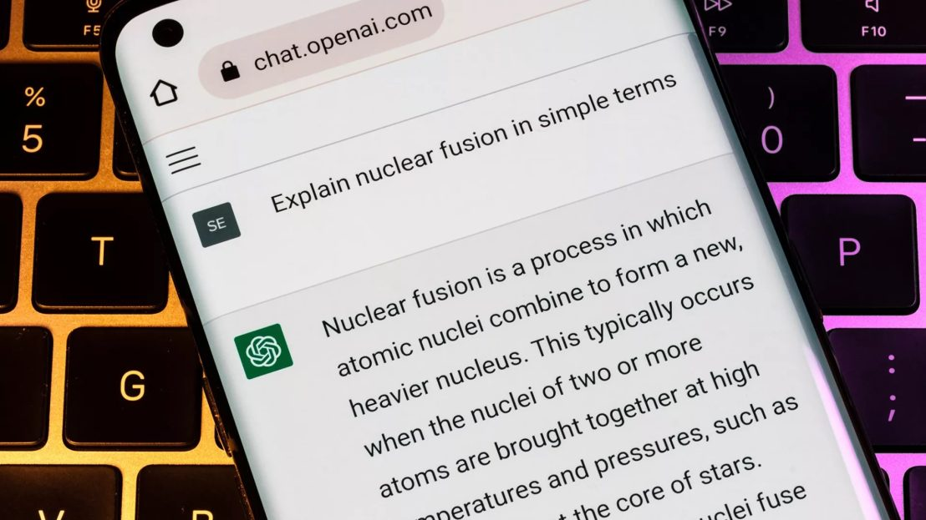
LLMs and ChatGPT
This Photo by Unknown author is licensed under CC BY-NC.

Slide 2

Generative AI:
A type of AI that uses large language models (LLMs) to generate new content, such as text, images, music, audio, and videos.
LLMS: A type of AI algorithm that uses deep learning techniques and massively large data sets to understand and generate content.
Examples: ChatGPT, DALL-E, Siri, Google Assistant
DALL-E: "Dog Riding a Bicycle"
Notes:
Anvit

Slide 3
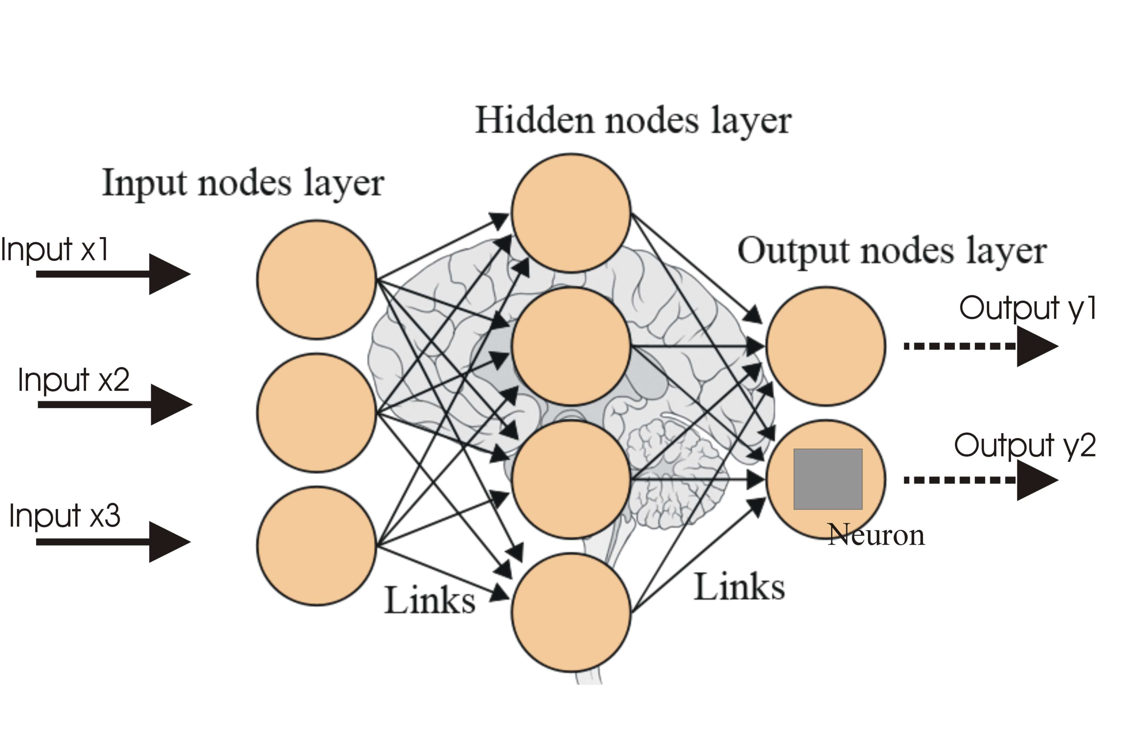
Neural Network
Neural networks are a type of machine learning model inspired by the human brain's structure and functioning.
Neurons
The most important units in a neural network
Layers:
Neurons get organized into layers, usually an input layer, one or more hidden layers, and an output layer
Input Layer: Where data is fed into the network
Hidden Layer: Intermediate layers that process information
Output Layer: Produces the final prediction or output
Notes:
Anvit

Slide 4
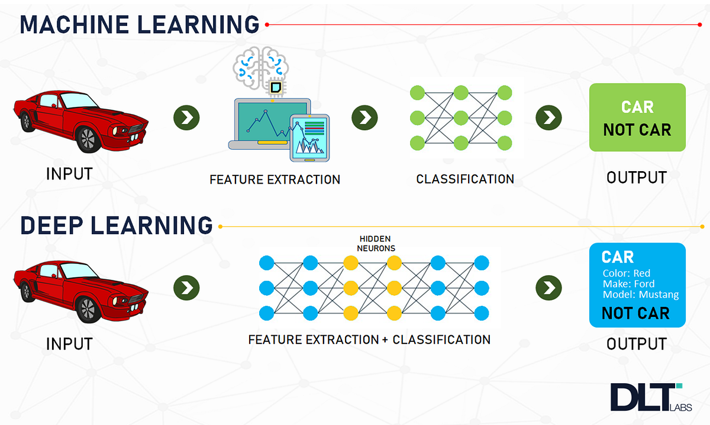
Deep Learning
Deep learning is a subfield of machine learning that focuses on neural networks with many hidden layers (deep neural networks).
01
Deep learning algorithms are designed to automatically learn and represent data by uncovering increasingly complex and structured patterns
02
This approach uses the power of deep neural networks to capture complex features and patterns in data, very useful for tasks involving large datasets and high-dimensional data. Ex: Image recognition
03
Notes:
Anvit

Slide 5
How large language models work?
The embedding layer creates embeddings from the input text. This part of the large language model captures the semantic and syntactic meaning of the input, so the model can understand context.
The feedforward layer (FFN) of a large language model is made of up multiple fully connected layers that transform the input embeddings. In so doing, these layers enable the model to glean higher-level abstractions — that is, to understand the user's intent with the text input.
The recurrent layer interprets the words in the input text in sequence. It captures the relationship between words in a sentence.
The attention mechanism enables a language model to focus on single parts of the input text that is relevant to the task at hand. This layer allows the model to generate the most accurate outputs.
Notes:
Tri

Slide 6

LLM Applications
Information retrieval: summarize and retrieve information
Sentiment analysis
Text generation
Code generation
Chatbot and conversational AI
Notes:
Anvit

Slide 7
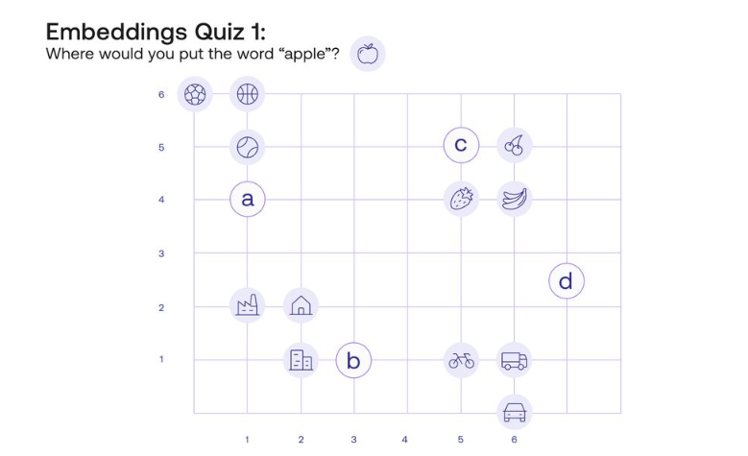
Words embeddings
Embeddings : convert complex and high-dimensional data to lower-dimensional representations

Slide 8
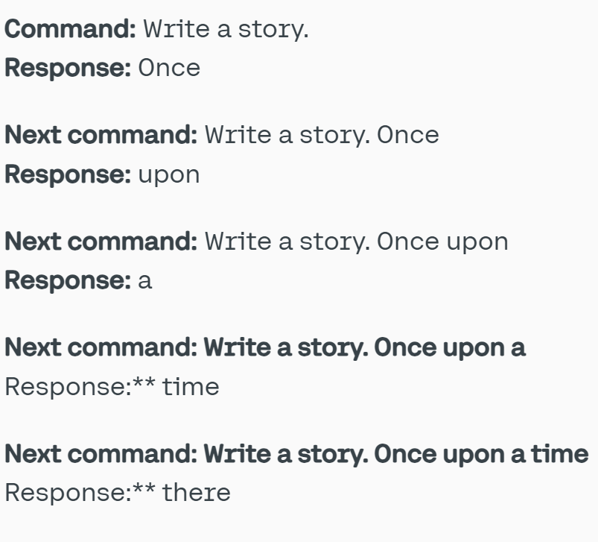
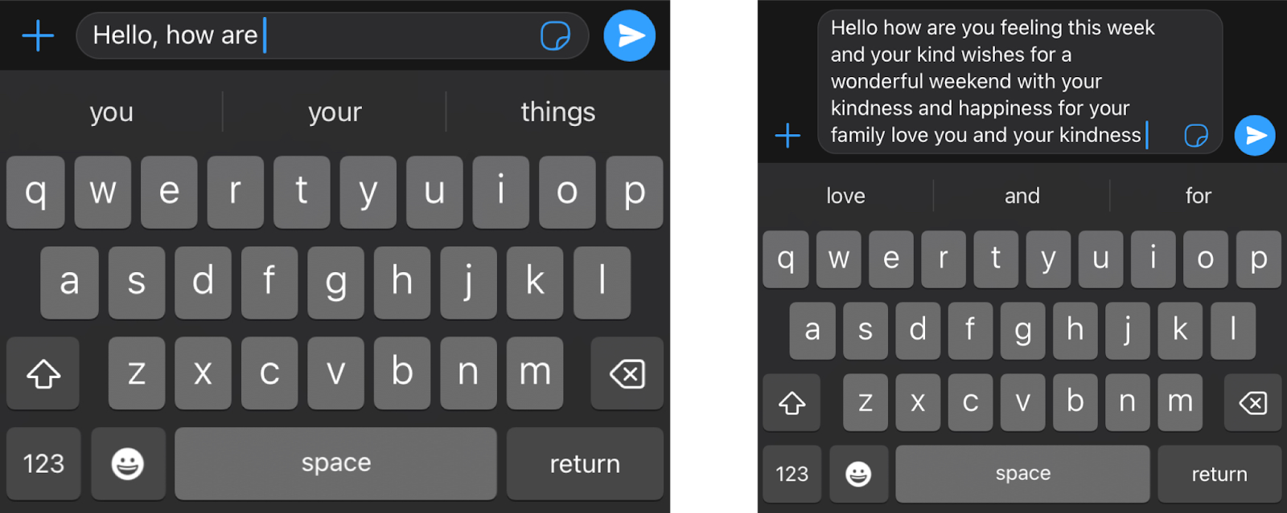
Transformer Models
A transformer model is a neural network that learns context and meaning by tracking patterns and relationships in sequential data like the words in this sentence.
They are text models that build one word at a time.
They are trained with all the data from the internet
Notes:
Anvit

Slide 9
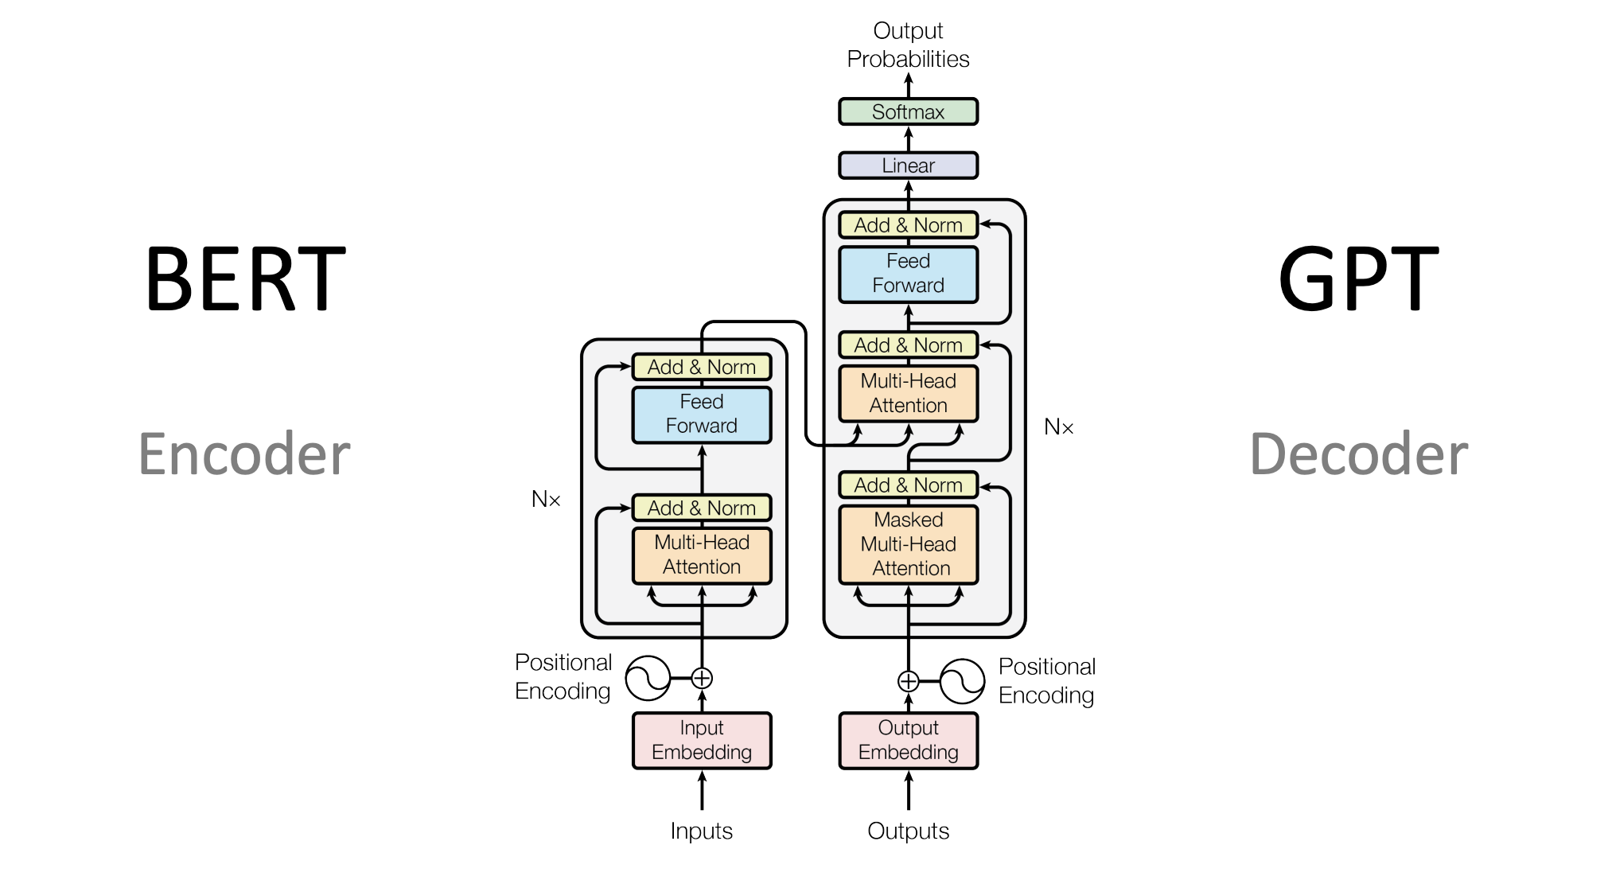

Slide 10

Self-Attention
Self-attention is a technique used to model dependencies and relationships between elements in a sequence.
Important in transformer models Transformer model is a neural network that learns context and thus meaning by tracking relationships in sequential data like the words in this sentence
Ex: Translate "The cat in the hat" into French. First, we break the sentence down into tokens: ["The", "cat", "in", "the", "hat"] Each token gets represented as a vector through word embeddings. Vectors capture the meaning and context of the words The self-attention mechanism allows each word to focus on different parts of the input sentence. So when translating "cat", the model pays attention to "The" and "mat" for context. Finally, it then translates the sentence to "Le chat dans le chapeau"
Notes:
Anvit

Slide 11
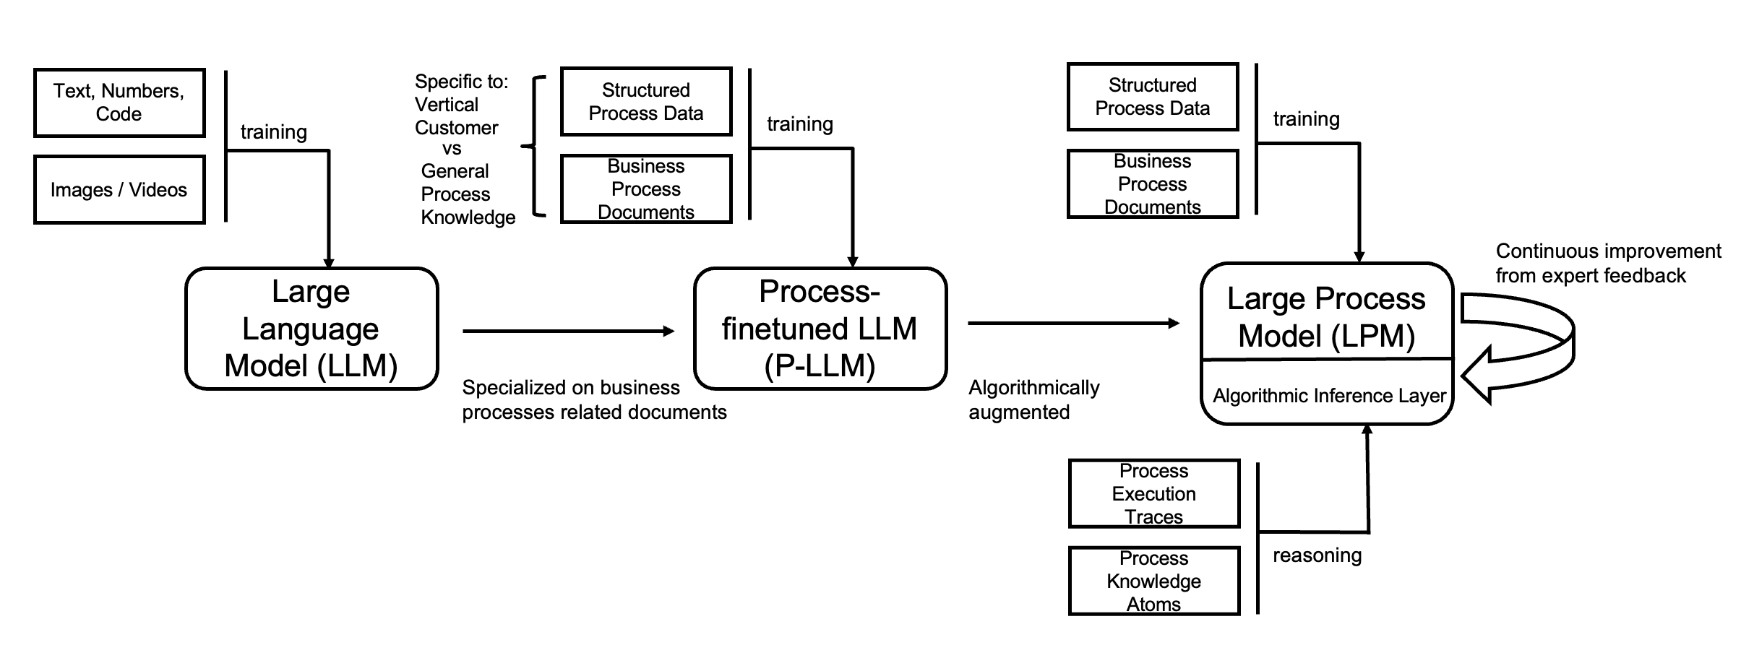
Fine-tuning model
Fine-tuning involves training the pre-trained model on a smaller, task-specific dataset.
This labeled dataset will rerun the model with new parameters and weights to perform the task
Notes:
Tri

Slide 12
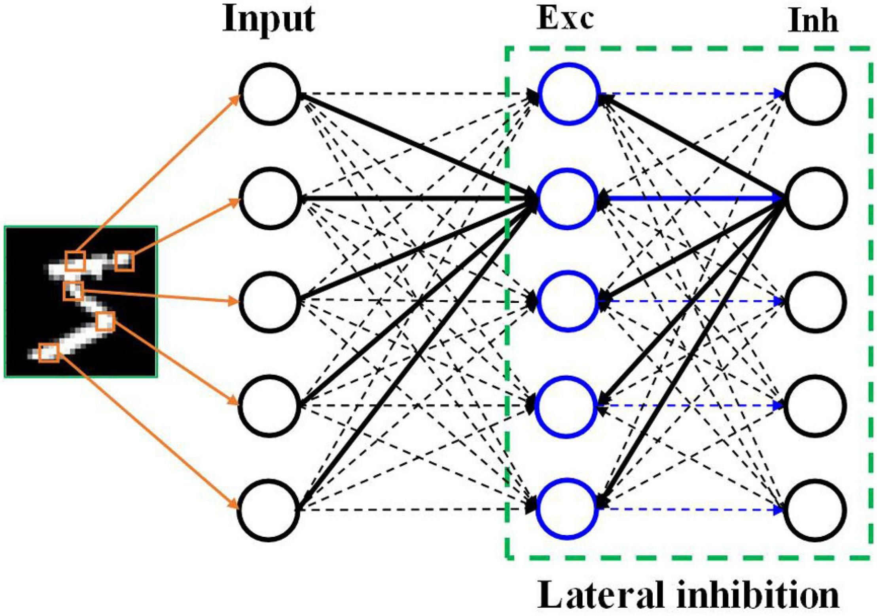
Transfer learning
Freeze certain layers of model during fine tuning
Or can add weights and new parameters but overall fewer than original models
Benefits:
Reduced time complexity and cost effective.
Lower hardware requirements: GPU
Improve model performance
Space-efficient storage
This Photo by Unknown author is licensed under CC BY.

Slide 13
ChatGPT Overview
ChatGPT has been designed to learn from a vast corpus of text data available on the internet, including books, articles, and websites
It then uses deep learning, a subset of machine learning, to analyze this data
After analyzing the data, ChatGPT can understand the patterns and structures of language, allowing it to generate human-like responses to questions and statements
Notes:
Anvit

Slide 14
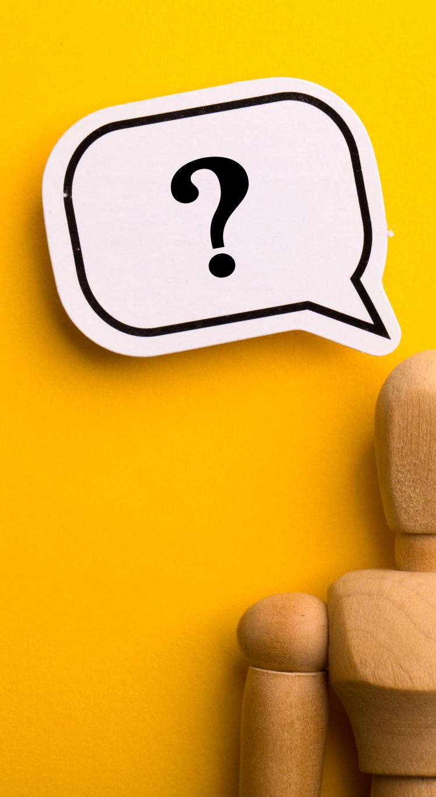
Limitations:
Self-attention means that the more information you provide in the input prompt, the more specialized the response will be because it will mix more of your words into its guesses
You're never “having a conversation” with an LLM so it doesn’t “remember” what has happened in an exchange.
Security: LLMs have important security risks when not managed or surveilled properly. They can leak people's private information, participate in phishing scams, and produce spam. Users with malicious intent can reprogram AI to their ideologies and contribute to the spread of misinformation.
Bias: The data used to train language models will affect the outputs a given model produces. As such, if the data represents a single demographic, or lacks diversity, the outputs produced by the large language model will also lack diversity.
Consent: LLMs are trained on trillions of datasets — some of which might not have been obtained consensually. When scraping data from the internet, LLMS often ignore copyright licenses, plagiarize written content, and repurpose proprietary content without getting permission from the original publishers.
Notes:
Tri

Slide 15

Sources
How does ChatGPT work?
Large Language Models
What Is A Neural Network?
What is a Transformer Model?
Transfer Learning and Fine-Tuning
Illustrated: Self-Attention

